Slide 1
Lion’s Day October 16, 2022
Department of English
Home to Creative, Curious, and Critical Thinkers
Effective and Empathetic Communicators
Working across industries and professions!
Presenters:
Dr. Felicia Steele, Associate Chair
Dr. Samira Abdur-Rahman, Assistant Professor

Slide 2
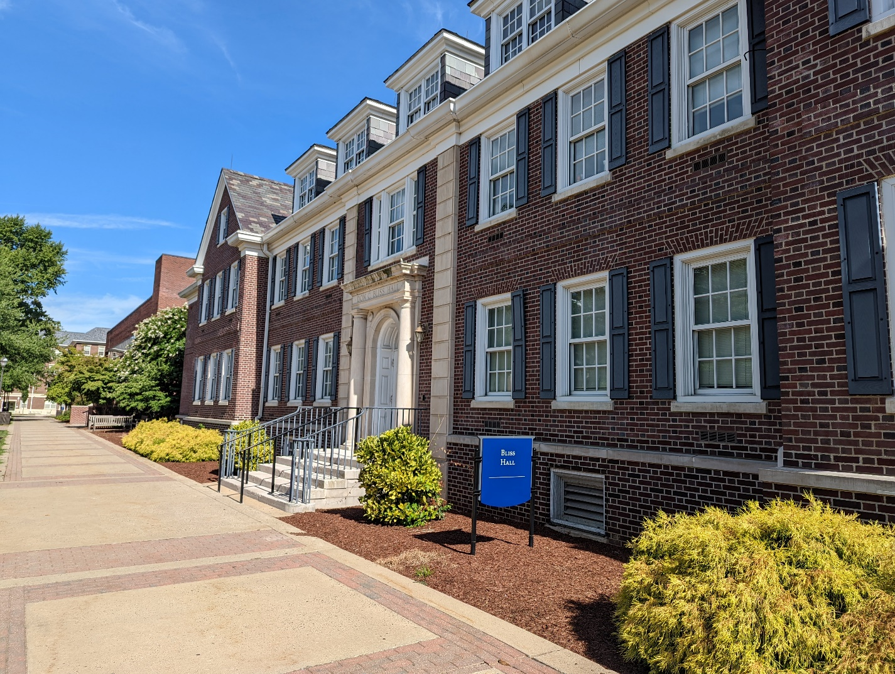
Bliss Hall, Home to the Department of English

Slide 3
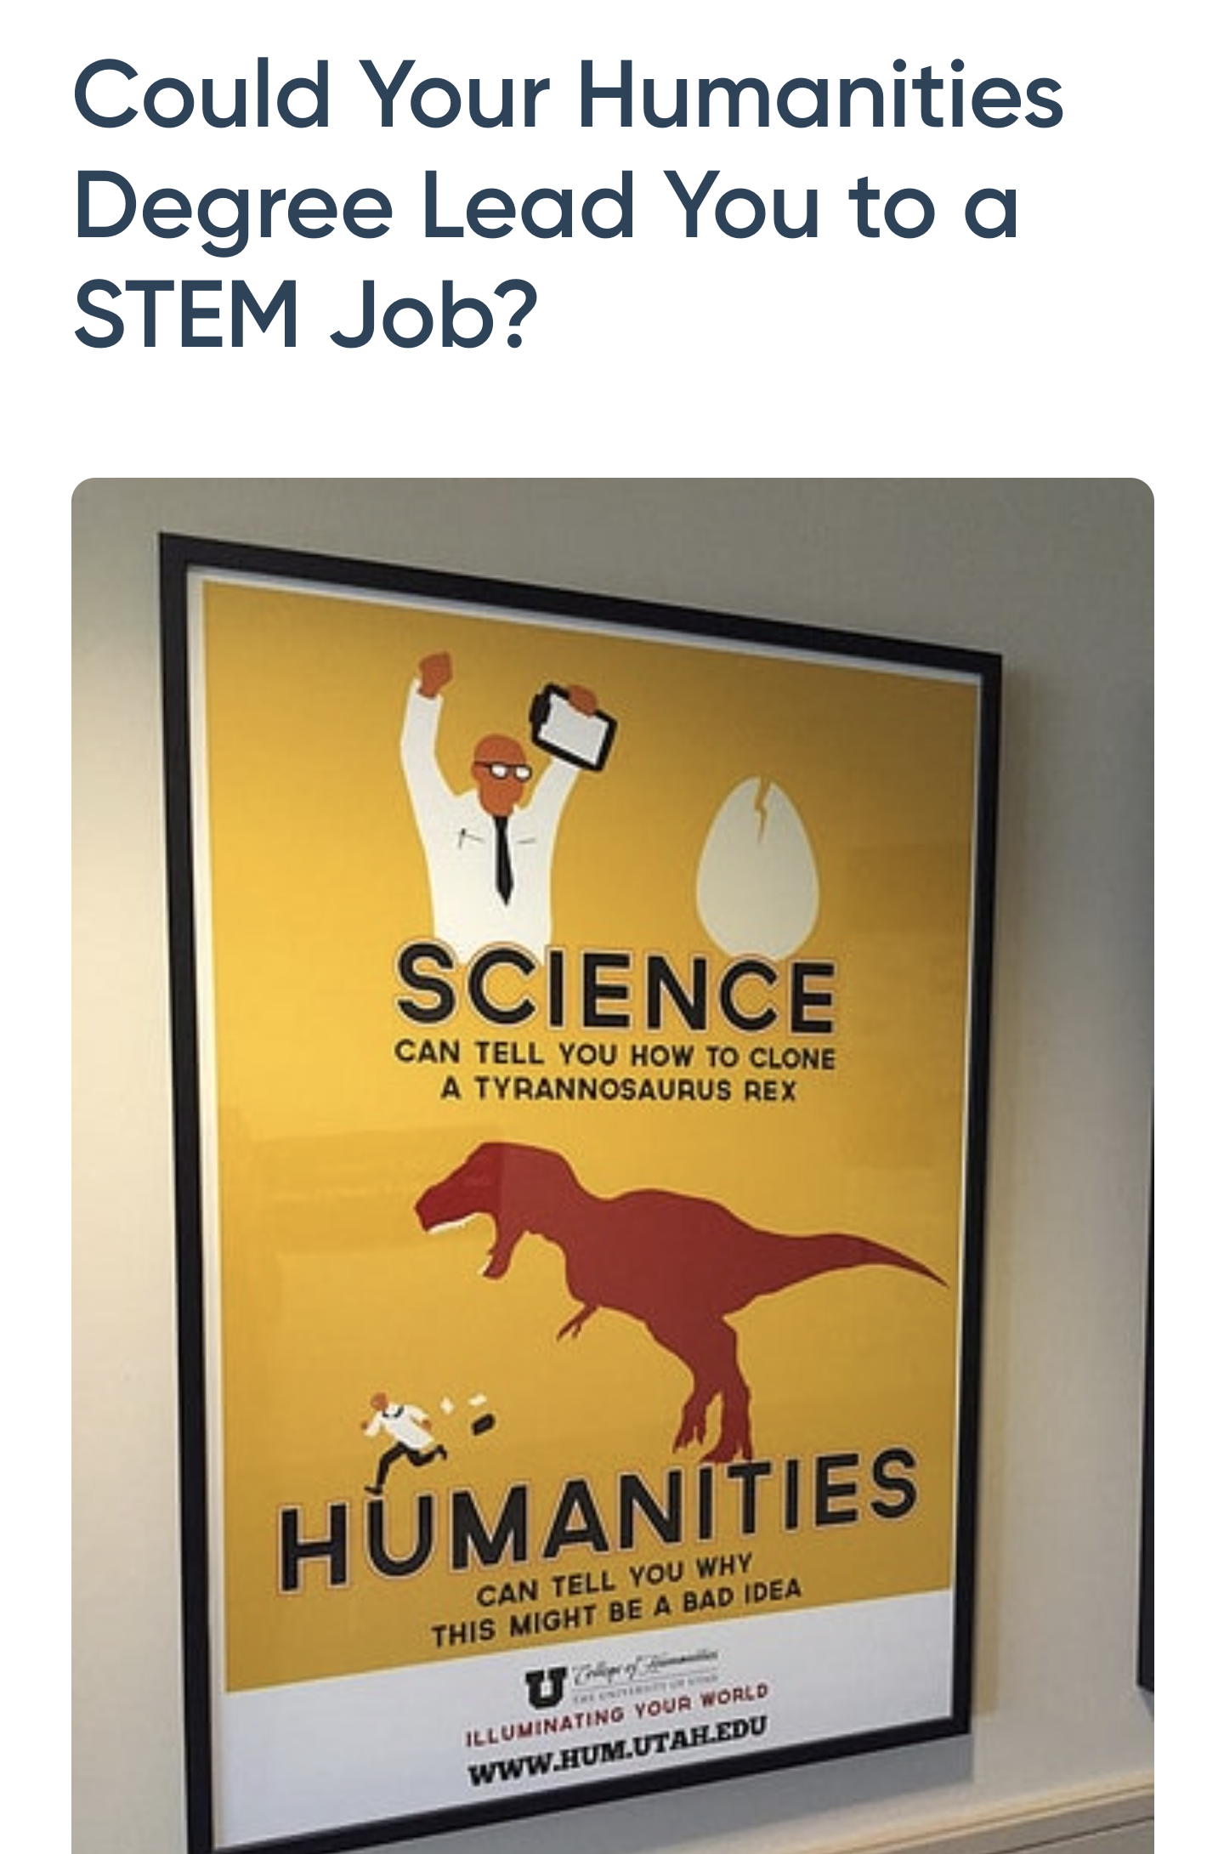
Why English? Why TCNJ?
Seventeen full-time faculty responsible for all student advising.
Five part-time faculty who contribute special skills.
No classes bigger than 30 students.
No Teaching Assistants
Notes:
Welcome, everyone, to the Academic Breakout Session for the Department of English here at TCNJ! I’m Dr. Felicia Steele, associate professor and associate chair of the Department of English. I’m very happy to be joined by Dr. Samira Abdur-Rahman, assistant professor, who joined us last year. I know that you’re all here to learn a little bit more about the Department of English here at TCNJ, but before I begin enthusiastically and shamelessly bragging about my department and the alumni from our department, I want to make our role here absolutely clear. We’re here to persuade you that you will find a home in our English department and that you will benefit—across the whole of your life—from joining our community when you begin college. So I’m going to address the first question that you may have asked your student: “Why English?” I’ve pulled some of my favorite headlines and quotations from Inside Higher Education, the major “trade publication for colleges and universities,” from USA Today, and from PayScale. Despite all the cautionary tales you may have heard, students in the Humanities, especially students who have studied literature, writing, and language, are preparing themselves for every industry and for every field, including the STEM fields that you hear the most about. It is, after all, the students trained in English who are able to communicate the findings of scientists and Engineers to the general public and to funders. But why TCNJ and not somewhere else? Well, because TCNJ’s English Department is Home to Creative, Curious, and Critical Thinkers who are Effective and Empathetic Communicators. Our classes are small and we use a model of faculty advising rather than “professional advising” to support students as they move through their curriculum. As a result, all English majors have at least one faculty member who knows them well and can help them find internships and can recommend them confidently and accurately for graduate school or to employers. Since none of our classes is larger than 30, we all know students’ names. And we maintain those relationships long after their graduation, once they are out in the world, working across industries and professions!

Slide 4
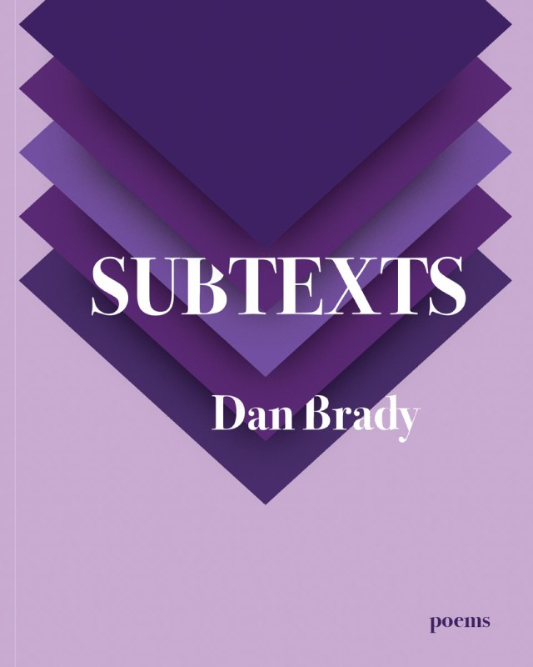
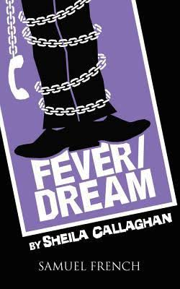
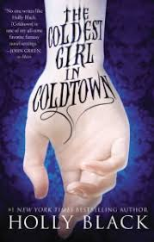
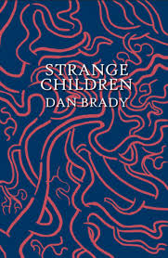
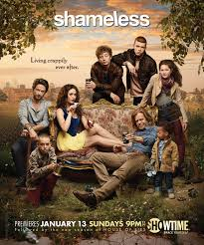
Who are we?
Writers!
Notes:
Our alumni are writers. You may have heard of a novelist who has written a book or two—she may be best known for the Spiderwick Chronicles, but Holly Black is a TCNJ alumna, as is Sheila Callaghan, playwright, screenwriter, and producer; two of our more recent alumni, Sarah Blake and Dan Brady gave readings here last year in celebration of their newest books, Clean Air, and the book of poems, Subtexts. Nicole Zamlout’s book of poetry, All these little stars is especially wonderful to me. She graduated two years ago, and her work is published by another alumna, who runs the non-profit literary publisher, ReadFuriously, which is dedicated to advancing New Jersey writers.

Slide 5
Technical and Advertising Copy Writers!
Notes:
But not all the writers who come from TCNJ have aspirations to write poems, plays, and novels. Many have successful careers as copywriters and technical writers. And they write not only for literary outlets, but for the pharmaceutical industry, for investment banks, for major universities, including Harvard, for magazines, for major corporations, and for game companies! You and your families may recognize a few of these!

Slide 6
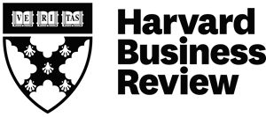
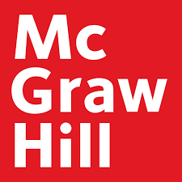
Publishing!
Notes:
Over the last twenty years, TCNJ has broken through the Ivy ceiling in the publishing industry, and you will find our alumni in editorial, marketing, rights and permissions, and copywriting in every major publisher in the United States, and at every rank, from editorial assistant to executive editor. And, as I said earlier, we even have alumni who have started their own publishing houses. You will also find them in all sectors of the publishing industry, including academic, industry, and literary book, audiobook, and magazine publishing. In addition, they run bookstores and run corporate and institutional publishing.

Slide 7
The Professions
Law
TCNJ has just started a 3+3 partnership with Villanova University.
Medicine
TCNJ’s 7-year medical program is also open to English majors.
Counseling
Many of our students complete the TCNJ Counselor Education program after graduation or double-major in English and Sociology and join the Bryn Mawr Social Work Program.
Librarianship
Alumni are academic librarians, non-profit organization researchers, school librarians, and community librarians.
Notes:
Our graduates attend law schools throughout the US: the University of Texas at Austin (a personal favorite, since it is my graduate alma mater), Northeastern, Duke, Seton Hall, Villanova, Drexel, and many others. But TCNJ also has a new and exciting opportunity for applicants for the Class of 2026 and onward. We have a new partnership with Villanova University. Students can apply simultaneously to TCNJ and Villanova and will be awarded their TCNJ degree at the end of their first year in law school. Our English Liberal Arts program is excellent preparation for medical school, especially for students interested in community and family medicine and can easily serve as a double major with Public Health, Biology, or Mathematics. In addition, English is one of the majors in the TCNJ 7-year medical program, where students complete three years at TCNJ and their MD at New Jersey Medical School. Since the English major helps create empathetic communicators, many of our students pursue post-graduate degrees in counseling, some here at TCNJ. Our alumni are school counselors, crisis counselors, social workers, and professionals in HR. Since the English major also helps to create critical thinkers, many of our students leverage their skills in librarianship, some even becoming faculty academic librarians. One of our faculty librarians here at TCNJ is an alumnus of the English major.

Slide 8
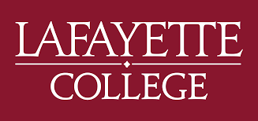
Scholars, Librarians, Instructional Designers, Non-Profit Administrators
Notes:
Students also find success in academic careers or careers as instructional designers and administrators of major non-profit arts and literacy organizations. The English major promotes and encourages curiosity and creativity, and our graduates teach at a number of colleges and universities across the country and work in development and fundraising for major arts and educational foundations.

Slide 9
And Perhaps Most Significantly,
They are secondary educators (Grades 6-12),
principals, and superintendents throughout
New Jersey and the World!
Notes:
And I want think that putting secondary educators onto our last slide is slighting them, but this is something that people in my field, historical linguistics call the “topicalized position.” That which is last is, in many ways, the most important. None of you would be in this room right now if it weren’t for the middle school and high school teachers that you have had. And I suspect that one or two of them graduated from TCNJ. Every year, with each new crop of students, I get a little anxious that I’m going to need new jokes because you’ve already heard them reported to you. These maps only represent the students who graduate from the School of Humanities and Social Sciences as Secondary Education and Secondary Special/Urban Education, which are the majors housed in our department. We also work with a substantial number of students preparing to be K-8 educators who double major in Education and English. If you belong to that category, welcome, and know that you will find your home with us as well. Each year at graduation, many of our double-majors attend both ceremonies because they feel just as close to their faculty and peers in English as they do in Education.

Slide 10
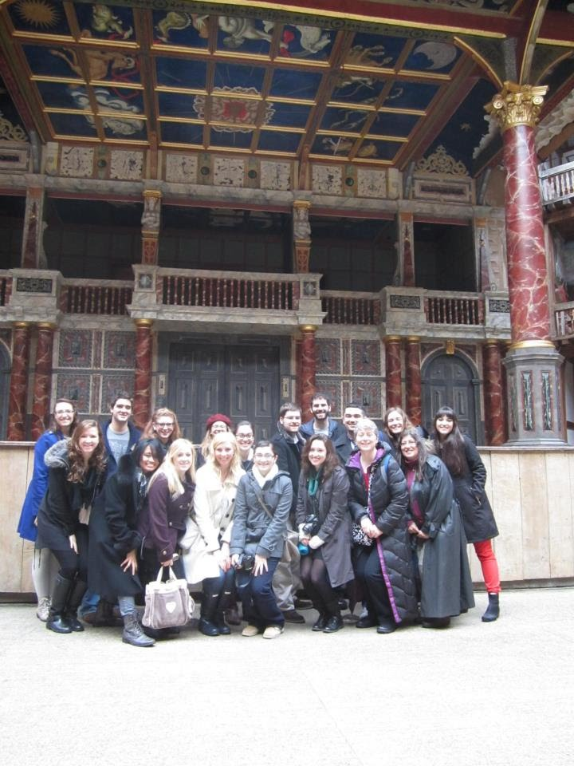
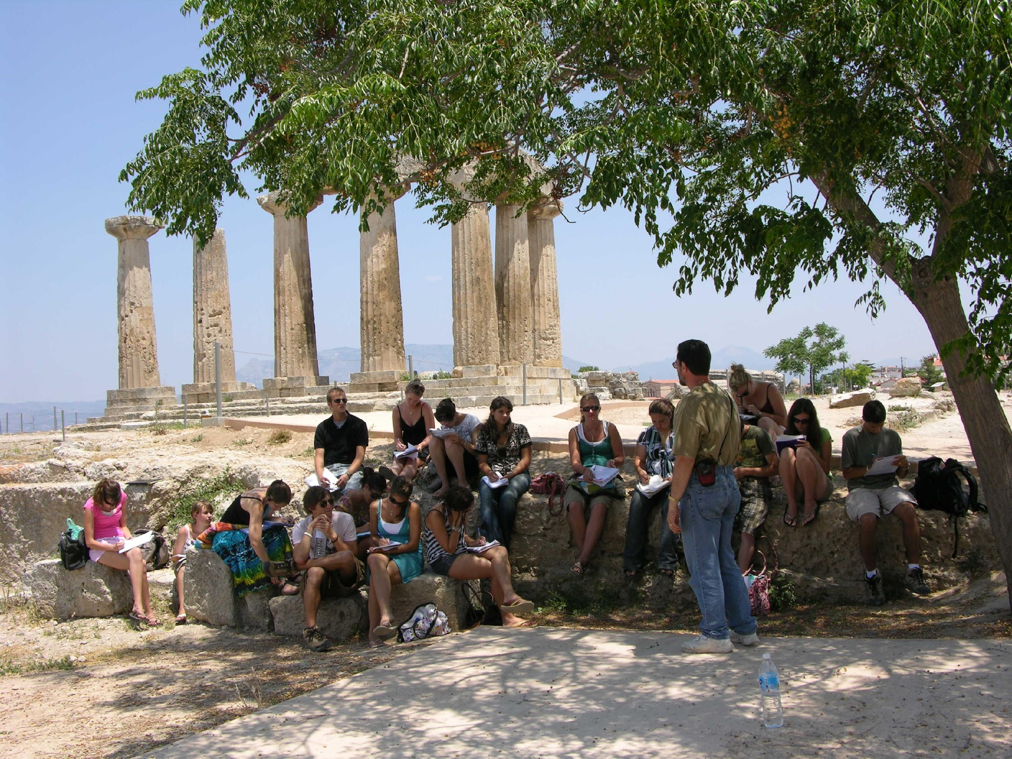
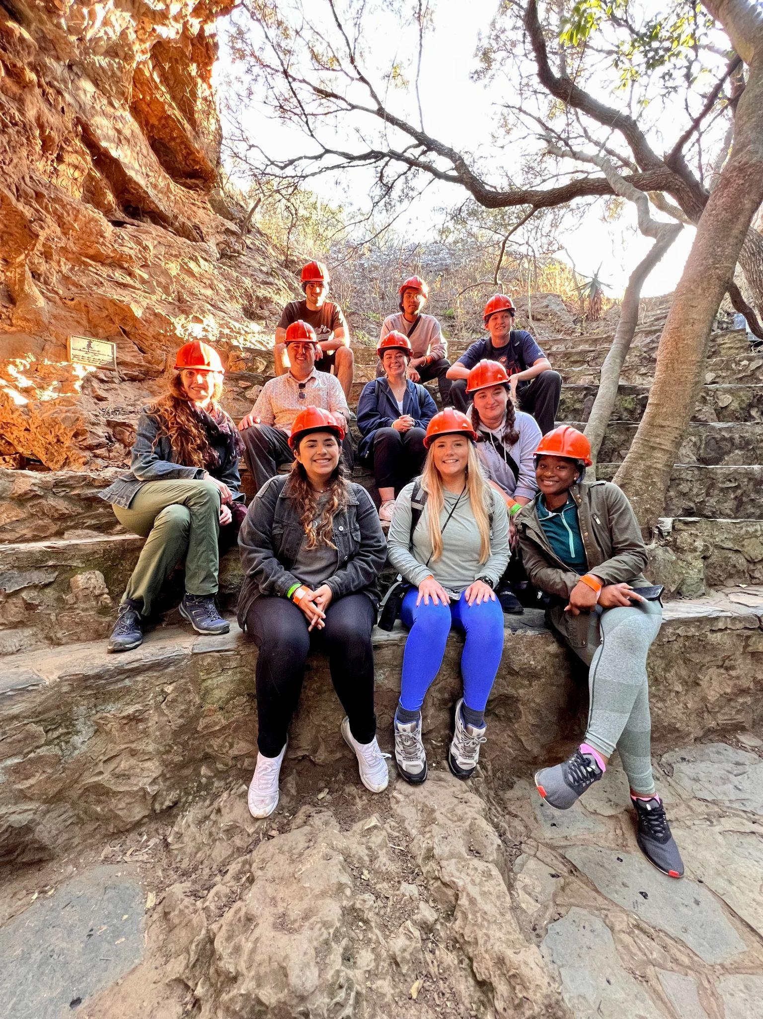
Opportunities Unique to TCNJ
Notes:
Before I open up for questions, I want to discuss some of the other things that make us special as a department. For one, we have the largest chapter of Sigma Tau Delta, the English Honor Society, of any “brick-and-mortar” traditional college in the world. Our students have won more than $45,000 in scholarships and won more than $7,500 in awards for their critical and creative work. Two of us serve on the national board of this honor society with over 900 chapters worldwide. Our literary magazine, The Lion’s Eye, was recognized last year as one of the outstanding literary arts journals in the country by Sigma Tau Delta. Each year, four faculty members (I’m among them) lead faculty-led study abroad tours to England, Greece, or South Africa. My trip is in the bottom left—we’re at the reconstructed Globe Theatre. These short-term study away courses provide students with intense, affordable, well-planned study abroad opportunities. As the world opens back up, they are an excellent option for students who want this experience, but may be reluctant to spend 15 weeks away from TCNJ. At the same time, however, our secondary educators can also do their teaching abroad, in Italy, Thailand, Spain, or Croatia. So even when you aren’t here at TCNJ, you will still, always find yourself part of the TCNJ community.

Slide 11
Enrollment Opportunities
MA Program
4+1 MA
3-Year Accelerated Program
For highly qualified and motivated Liberal Arts Majors
Notes:
TCNJ also has a graduate program in English as well that serves both traditional full-time graduate students and part-time students, professionals and teachers who take ten courses one or two at a time from anywhere between three and six years to completion. But we also have a program where students can complete either of our undergraduate degree programs (Liberal Arts or Secondary Education) and complete a master’s degree in one further calendar year. The English department is also one of three piloting departments in the School of Humanities and Social Sciences that is offering an accelerated degree program in liberal arts for highly qualified and motivated students. This program uses skilled and effective advising to move students through our existing liberal arts major in three, rather than four years. Now, from my perspective, the perfect outcome would be the union of these two opportunities, so that a student could complete both an BA and an MA in four years.

Slide 12
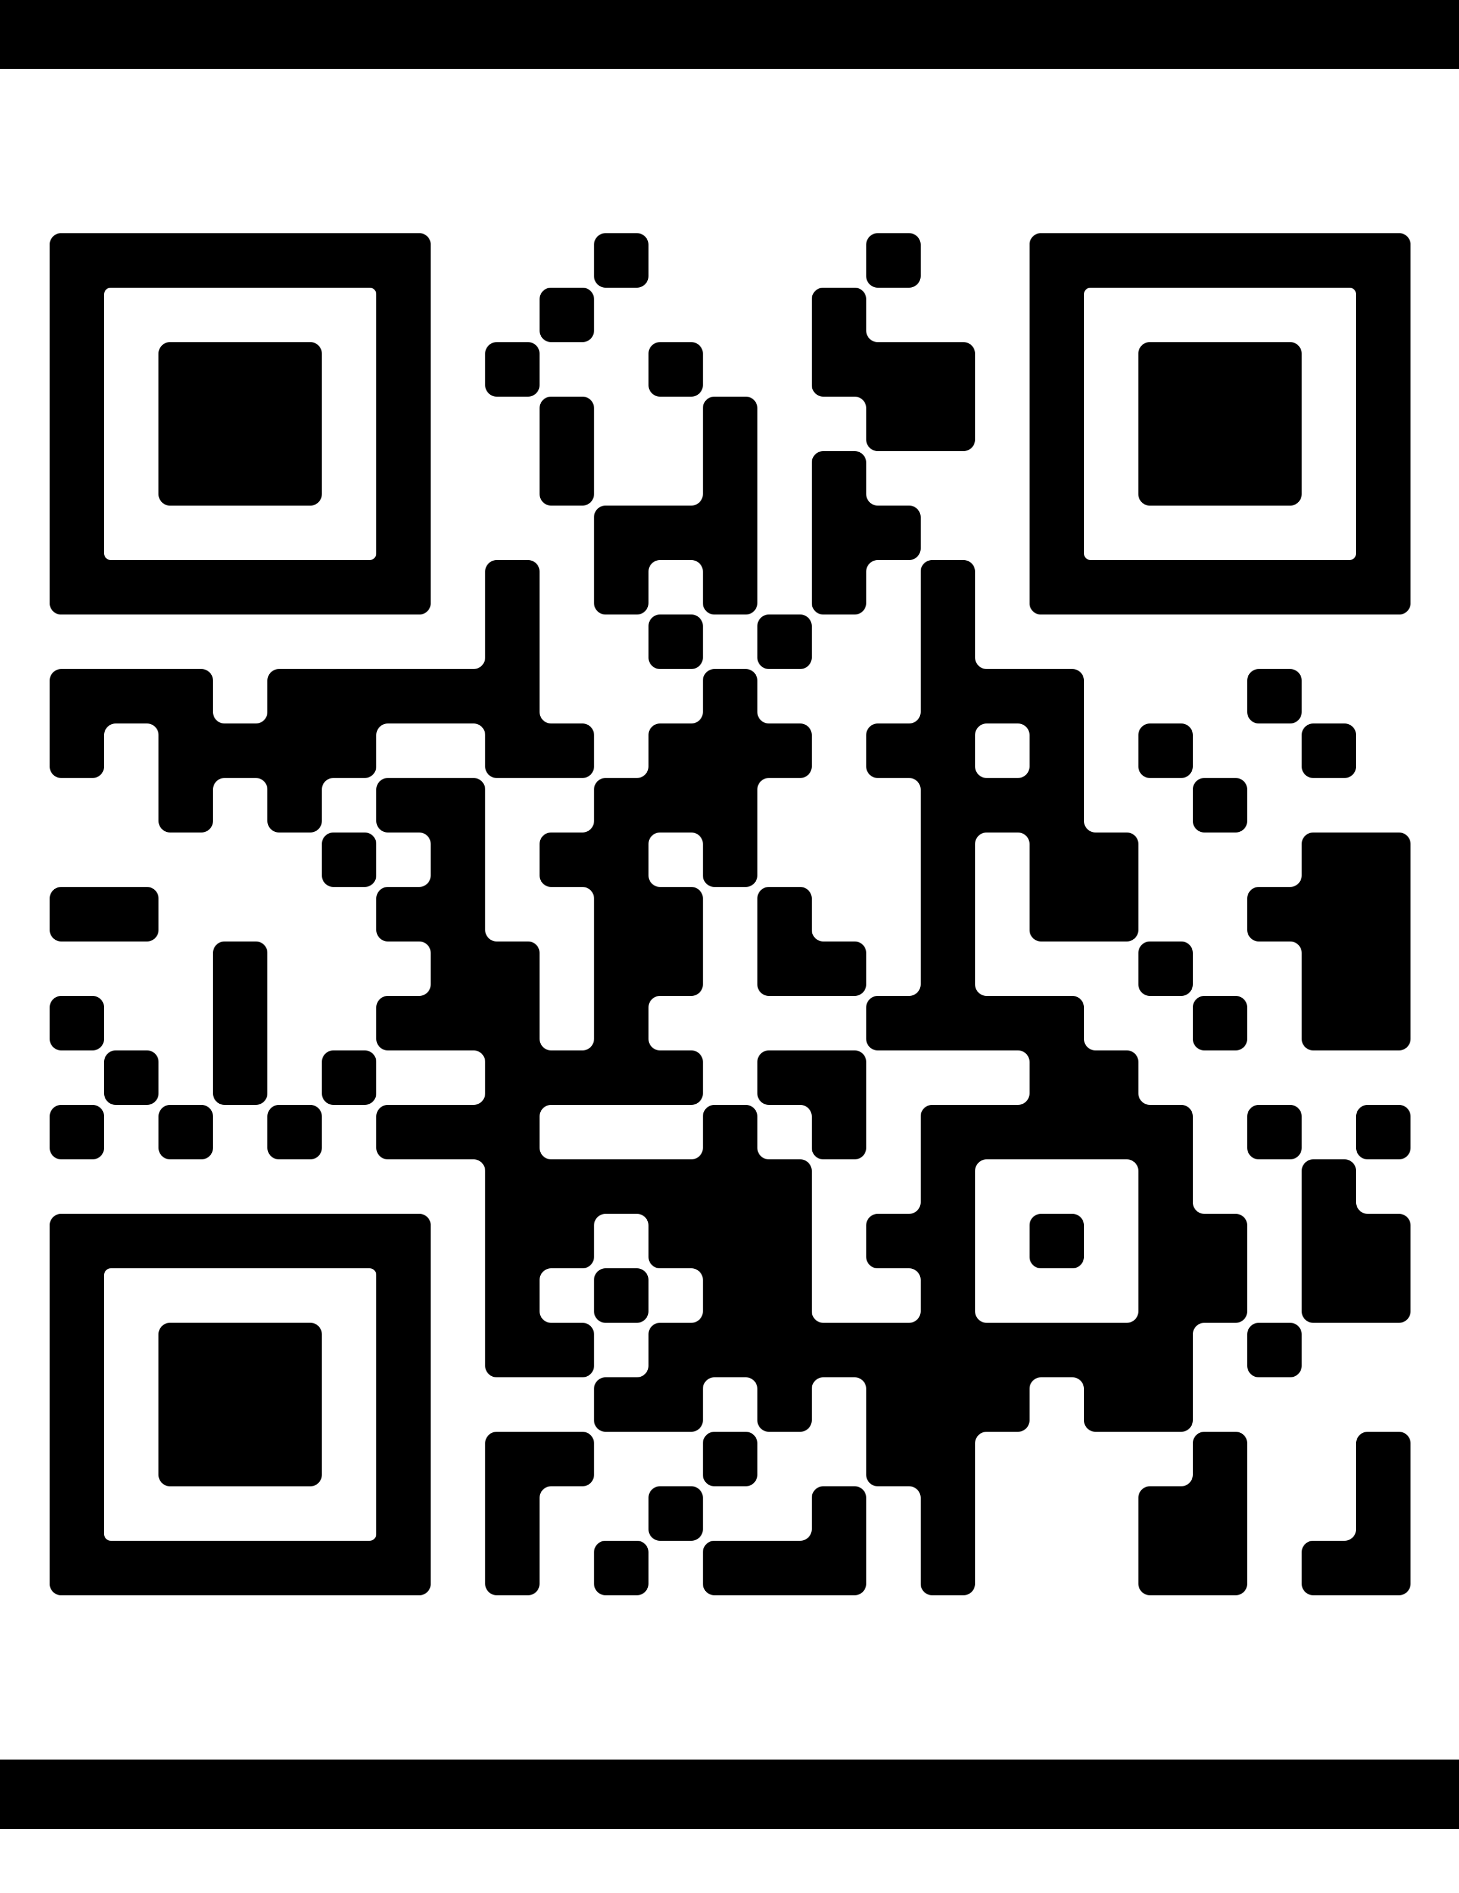
Questions?
Dr. Felicia Steele
steele@tcnj.edu
english.tcnj.edu
Please record your attendance today with this QR code.
Notes:
We have time for questions. I’ve also given you my email address, and our website address. This site has everything that you want to know about our faculty, curriculum, events, and course offerings. We also have a social media presence, so please follow us on Facebook, Instagram, or Twitter.
Please use this QR code to record your attendance at today’s session.

