Slide 1
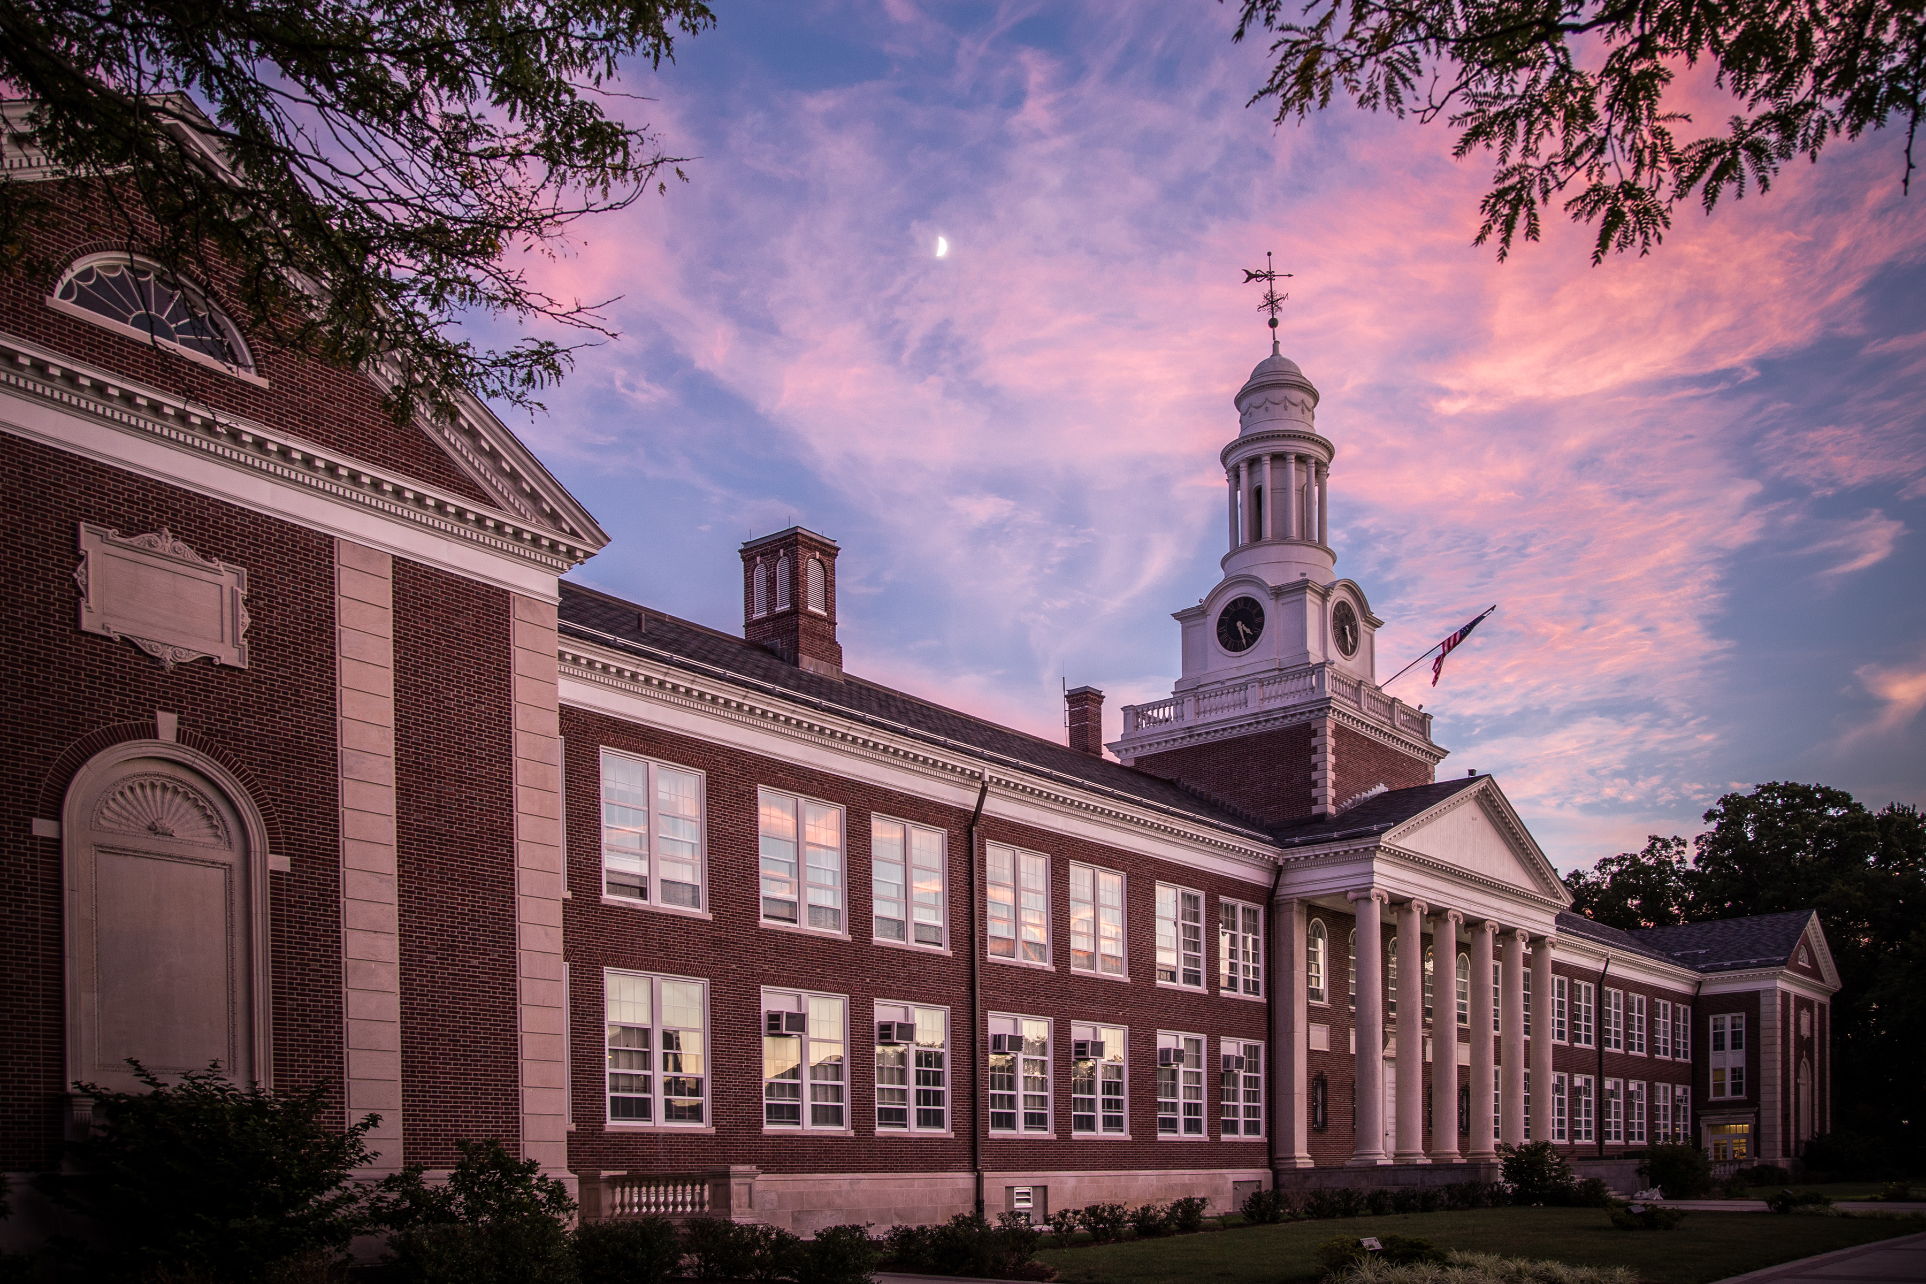
Repositioning HEL in the General Education Curriculum
Felicia Jean Steele
Sewanee Medieval Colloquium
Friday, April 9, 2021, Session 11
Department of English steele@tcnj.edu

Slide 2
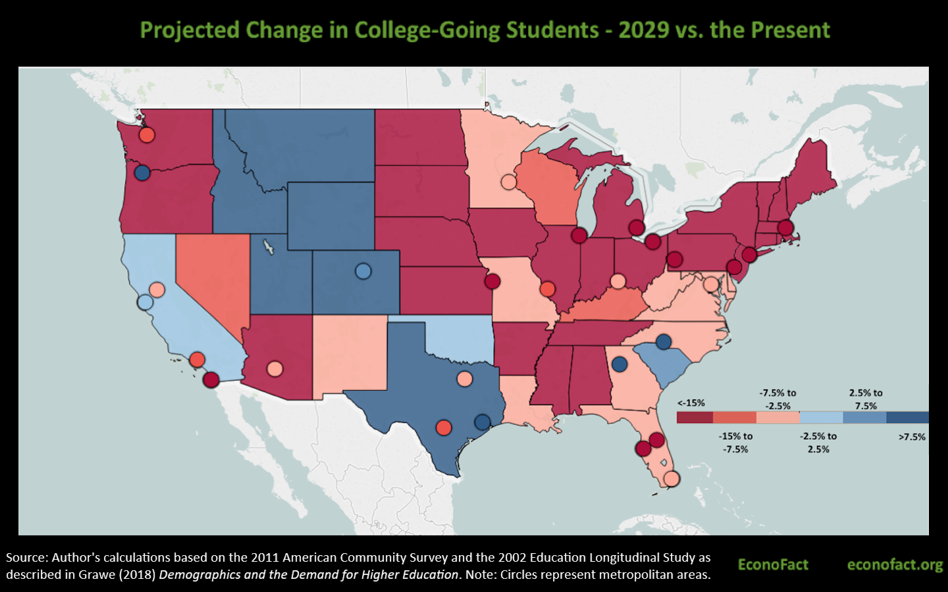
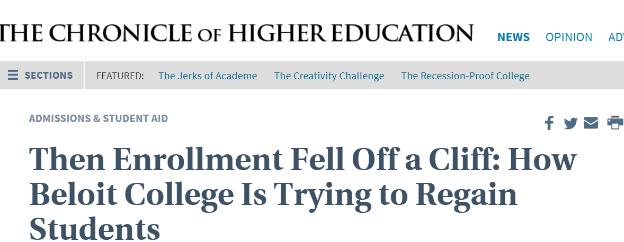

Slide 3
Institutional Assessment
NCATE Standards for English Language Arts Education Programs
Standard III
Element 5: Candidates plan instruction that incorporates knowledge of language—structure, history, and conventions—to facilitate students’ comprehension and interpretation of print and non-print texts

Slide 4
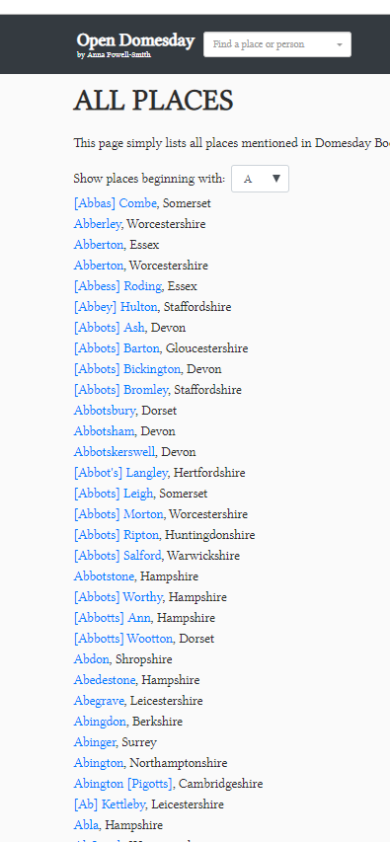
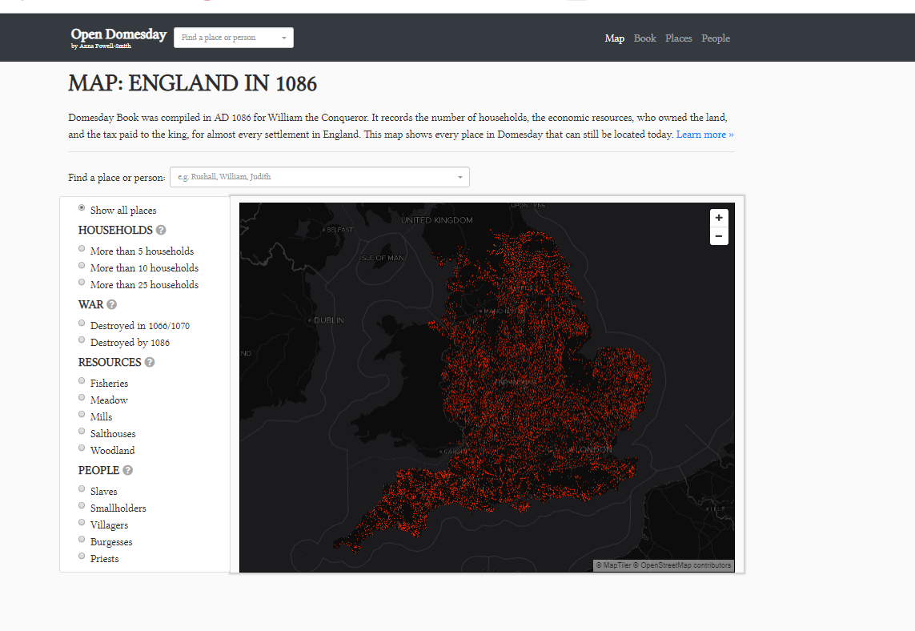
Open Domesday Project
https://opendomesday.org/place/

Slide 5
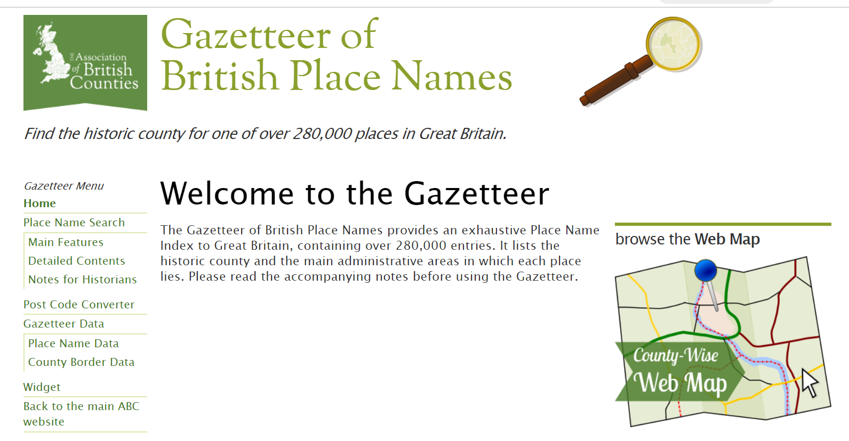
Gazetteer of British Place Names
http://gazetteer.org.uk/

Slide 6
My Maps in Google

Slide 7
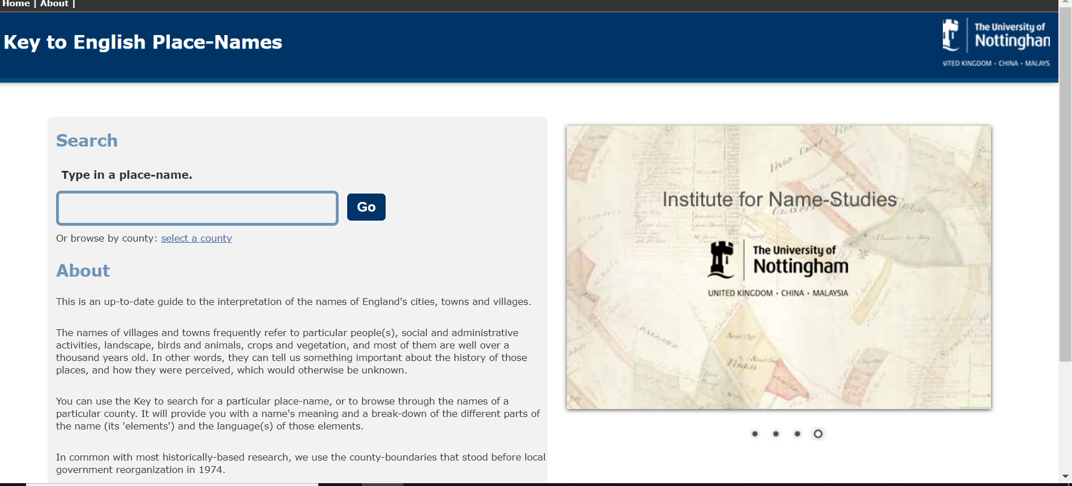
Key to English Place Names
http://kepn.nottingham.ac.uk/

Slide 8
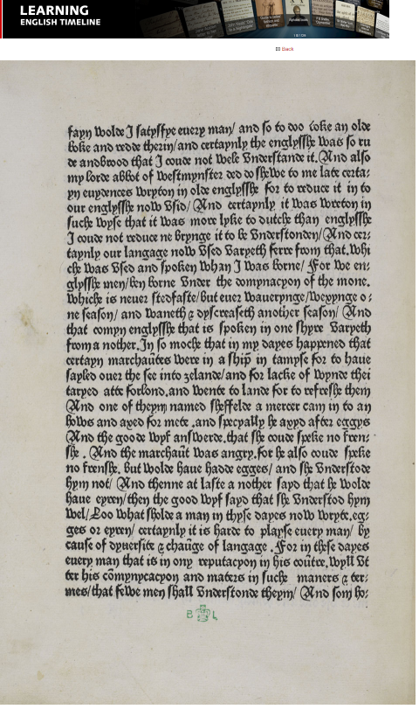
Caxton’s Eneydos
British Library Timeline: https://www.bl.uk/learning/timeline/item126611.html
Furnivall’s 1890 edition in Google Books: https://books.google.com/books?id=23I3bBFR8nsC&dq
Ellesmere Canterbury Tales: https://hdl.huntington.org/digital/collection/p15150coll7/id/2838/

Slide 9
OED Exercises

Slide 11
From the Dictionary of National Biography
The Pilgrimes (as it is usually known) was the culmination of almost twenty years' collecting oral and written accounts of travels in Europe, Asia, Africa, and the Americas. It was based in part on Hakluyt's remaining manuscripts, which Purchas had acquired about 1620...The Pilgrimes combined editing with editorializing to comprise the bulkiest anti-Catholic tract of the age and the last great English work of geographical editing for almost a century. Its four volumes traversed the world from the ancient Near East to the latest English colonies. (Armitage)

Slide 12
Works Cited
Armitage, David. "Purchas, Samuel (bap. 1577, d. 1626), geographical editor and compiler and Church of England clergyman." Oxford Dictionary of National Biography. May 24, 2007. Oxford University Press. Date of access 7 Jan. 2020,
Curzan, Anne. "Prescriptivism and Teaching HEL." In Moore and Palmer, 178-186.
"jackal, n." OED Online, Oxford University Press, December 2019, www.oed.com/view/Entry/100499. Accessed 7 January 2020.
Menzer, Melinda. "HEL and General Ed Requirements: Finding a Place in the Liberal Arts Curriculum." In Moore and Palmer, 253-258.
Moore, Colette, and Chris C. Palmer. Teaching the History of the English Language. Modern Language Associaton of America, 2019.
Townend, Matthew. "Contacts and Conflicts: Latin, Norse, and French," in Lynda Mugglestone, ed. The Oxford History of the English Language. Oxford University Press, 2008.
All materials available at steele.pages.tcnj.edu

